Slide 1
7 ELECTROCHEMISTRY
Potentiometric titration
Dr.Rani Pavithran
Assistant Professor
Department of Chemistry
College of Engineering Trivandrum

Slide 2
Potentiometric titrations
The potential of an electrode depends up on the concentration, to which it is reversible in accordance with Nernst equation.
In Potentiometric titrations, the change in the electrode potential upon the addition of the titrant is noted.
The volume of the titrant added is plotted against EMF.
At the end point the rate of change of potential is maximum.

Slide 3


Types of Potentiometric Titrations
Both acid-base and redox titrations can be followed potentiometrically
Redox titration:
Redox reactions can be followed by an inert indicator electrode, a bright platinum wire or foil.
Consider the general reduction reaction
The potential of the indicator electrode is

Slide 4

Redox titration
This titration involves the transfer of electrons from the substance being oxidized to the substance being reduced.
The end point of a redox reaction can be determined by potentiometric titration.
Consider the oxidation of Fe²⁺ to Fe³⁺ by Ce⁴⁺ in acid medium.
Here we have to consider the following standard reduction potentials.

Slide 5

Redox titration
The Ce⁴⁺ ion has more reduction potential than Fe³⁺ therefore Ce⁴⁺ undergo reduction and capable of oxidizing Fe²⁺ to Fe³⁺.
The redox reaction can be depicted as

Slide 6
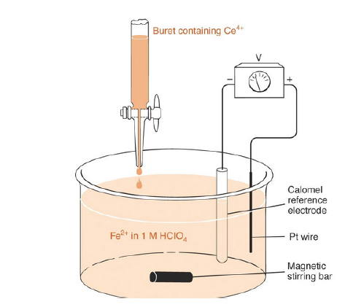
Procedure: 20ml ferrous sulphate solution (say 0.1N) is taken in beaker and 20ml 4N H₂SO₄ is added to provide acidic medium.
A platinum electrode is inserted into it. A saturated calomel electrode is then coupled as shown in Fig. The potential difference between the electrodes can be measured with a digital voltmeter. Standard ceric ammonium sulphate solution is taken in the burette and added to the acidified ferrous sulphate solution in the beaker in 1ml instalments and the EMF is noted in the voltmeter for each addition. EMF is plotted against the volume of ceric solution. The titration is repeated more precisely by adding 0.1ml each near the end point.

Slide 7
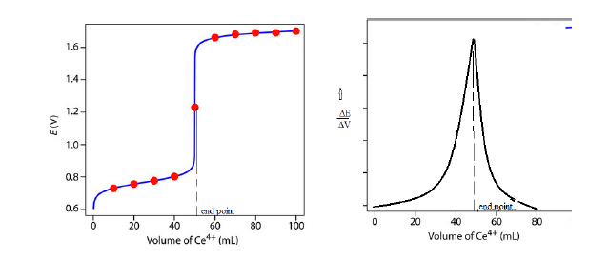
When Ce⁴⁺ solution is added from a burette to Fe²⁺ solution in a beaker, the concentration of Fe³⁺ increases due to oxidation of Fe²⁺ . As a result the potential of indicator electrode increases.
When the end point is reached, no more Fe²⁺ is available for oxidation, then Ce⁴⁺/Ce³⁺ electrode begins to setup.
Near the end point, the potential increases sharply. The end point is the point where the rate of change of EMF, ΔE/ΔV is maximum.
(Before the end point the redox electrode potential was lower due to Fe³⁺/Fe²⁺ system, which has lower E⁰ value 0.77V. After the endpoint Ce⁴⁺/Ce³⁺ electrode is set up which has higher E⁰ value 1.60V)

Slide 8

The oxidation of Fe²⁺ solution can also be followed potentiometrically using potassium permanganate solution or potassium dichromate solution in acid medium. The possibility is evident from their standard reduction potentials
Advantages of Potentiometric Titrations
It can be used in the case of coloured liquids where ordinary indicators cannot work.
2. Apparatus required is simple, cheap, reliable and readily available.
3. Solutions containing mixture of solutes can be accurately analyzed.
4. It can be used in precipitation titrations.

Slide 9
Types of Electrochemical cells
Commercial cells which are used as sources of electrical energy are of three main types:
Primary cells, secondary cells and fuel cells
Primary cells
based on cell reactions which are not reversible
Once the cell reaction is complete, the cell is discharged and cannot be recharged again
e.g. Weston Cd cell, Leclanche cell (dry cell) etc.
When a Daniel cell or dry cell is allowed to recharge, the reduction of Zn²⁺ to Zn metal does not take place at the anodic compartment, but evolution of H₂ takes place.

Slide 10
Secondary cells (Storage cells or Accumulators)
They are galvanic cells in which the cell reaction can be reversed by applying an external source of current.
These can be discharged and recharged many times until the electrode material last e.g. Lead- acid battery, Ni-Cd battery, Li-ion cell etc.
The term battery is normally used to denote a number of galvanic cells connected in series.
When cells of the same type are connected in series, their emf get added.
When they are connected in parallel, emf remains the same as that of a single cell but internal resistance of the combination get halved. Thus more current can be drawn from the cell without much drop in potential.

